Slide 1
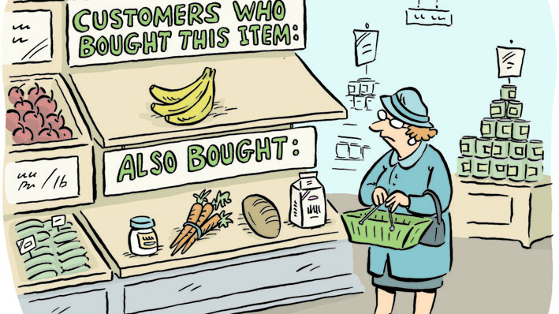
Market Basket Analysis Paris Baguette

Slide 2




Interpret
Results
Next Steps
Objective
Method

Slide 3
Objective
Identify association between products
Bundling offers or Promotions
Increase quantity of purchased items

Slide 4
Method (I/IV): Association Rule Mining
Technique used to find association between items
if X, then Y
X (antecedent) → Y (consequent)
Support Popularity of two items combined. % of total transactions
Confidence Likelihood that Y is bought when X is bought.
Lift Increase in ratio of X sold when Y is sold

Slide 5
Method (II/IV): Apriori Algorithm
Uses frequent item sets to find association rules
Minimum support threshold to remove infrequent item sets

Slide 6
Method (III/IV): Apriori Analysis
Item Category
Item Group*
Bread
Beverage
Dessert
Cake
Deli
Hot Meal
Pastry & Pie
Sweet Bread
Savory Bread
Sandwich
Non-Coffee
Donut
Coffee
*Top 7 groups

Slide 7

Method (IV/IV): Lift
Combination of Support and Confidence
Lift < 1: Weak or negative association
Lift > 1 & $≤$ 2: Positive association.
Lift > 2: Strong and actionable association.

Slide 8
Interpreting Results: Associated Item Sets with Lift > 1 (in order)
Antecedents
Consequents
HOT MEAL-STARTER
HOT MEAL-MAIN COURSE
HOT MEAL-PASTA (DINING)
DELI-SALAD
HOT MEAL-STARTER
HOT MEAL-MAIN COURSE
HOT MEAL-PASTA (DINING)
DESSERT-CHOUX
BEVERAGE-NON COFFEE
DESSERT-TART
BEVERAGE-NON COFFEE
BEVERAGE-NON COFFEE
BEVERAGE-NON COFFEE
DELI-SANDWICH
BEVERAGE-COFFEE
BEVERAGE-COFFEE
BEVERAGE-COFFEE
DELI-SANDWICH
BEVERAGE-COFFEE
DESSERT-CHOUX

Slide 9
Interpreting Results: Lift Values (Dine-In)
Min support = 0.01
 | Bread-Donut | Bread-Pastry & Pie | Bread-Savory Bread | Bread-Sweet Bread | Deli-Sandwich
Bread-Donut |  |  |  | 3.66 | 2.12
Bread-Loaf Bread |  | 2.25 |  | 5.09 | 3.24
Bread-Pastry & Pie | 1.64 |  | 1.45 | 1.53 | 1.07
Bread-Sweet Bread |  |  | 3.05
Deli-Sandwich |  |  | 1.89 | 1.94
*Combinations with lift > 1

Slide 10
Interpreting Results: Support Values (Takeout)
Min support = 0.0001
 | Beverage-Coffee | Cake-Roll Cake | Cake-Sliced Cake | Deli-Sandwich
Beverage-Non Coffee | 1.05
Cake-Mini Cake |  |  | 1.58
Deli-Salad |  |  |  | 1.09
Dessert-Macaron |  | 1.23
*Combinations with lift > 1

Slide 11
Interpreting Results: Lift Values (Overall)
Min support = 0.001
 | Beverage-Coffee | Beverage-Non Coffee | Deli-Sandwich | Dessert-Choux
Beverage-Non Coffee | 1.03
Deli-Salad |  |  | 2.05
Dessert-Choux |  |  | 1.12
Dessert-Tart |  |  |  | 1.02
Hot Meal-Main Course | 1.36 | 2.50
Hot Meal-Pasta (Dining) | 1.25 | 2.45
Hot Meal-Starter | 1.64 | 2.50
*Combinations with lift > 1

Slide 12
Interpreting Results: Lift Values

Slide 13
Interpreting Results: Beverage-Non Coffee

Slide 14
Interpreting Results: Beverage-Coffee

Slide 15
Interpreting Results: Deli-Sandwich

Slide 16
Interpreting Results: Dessert-Choux

Slide 17
Thank You

